Slide 1






Hackimon – Our team members
Why we join?
Good learning program
Enjoy the latest IT trend
Explore the power of AI, Cloud & IoT to change the world
Hi! I am Michael working as Senior Lead Solution Architect for GLCM and Payment System in ASP.
Hi! I am Nick,. I am Business Analyst working in data visualization projects.
Hi! I am KK. I am Infrastructure Lead in Group Function.
Hi! I am Krystal. I am Global Portfolio Manager in RBWM
Hi! I am April. I am Development Manager working in Qlik Sense projects.
Hi! I am Catherine. I am working in GLCM IT for BI projects.

Slide 2
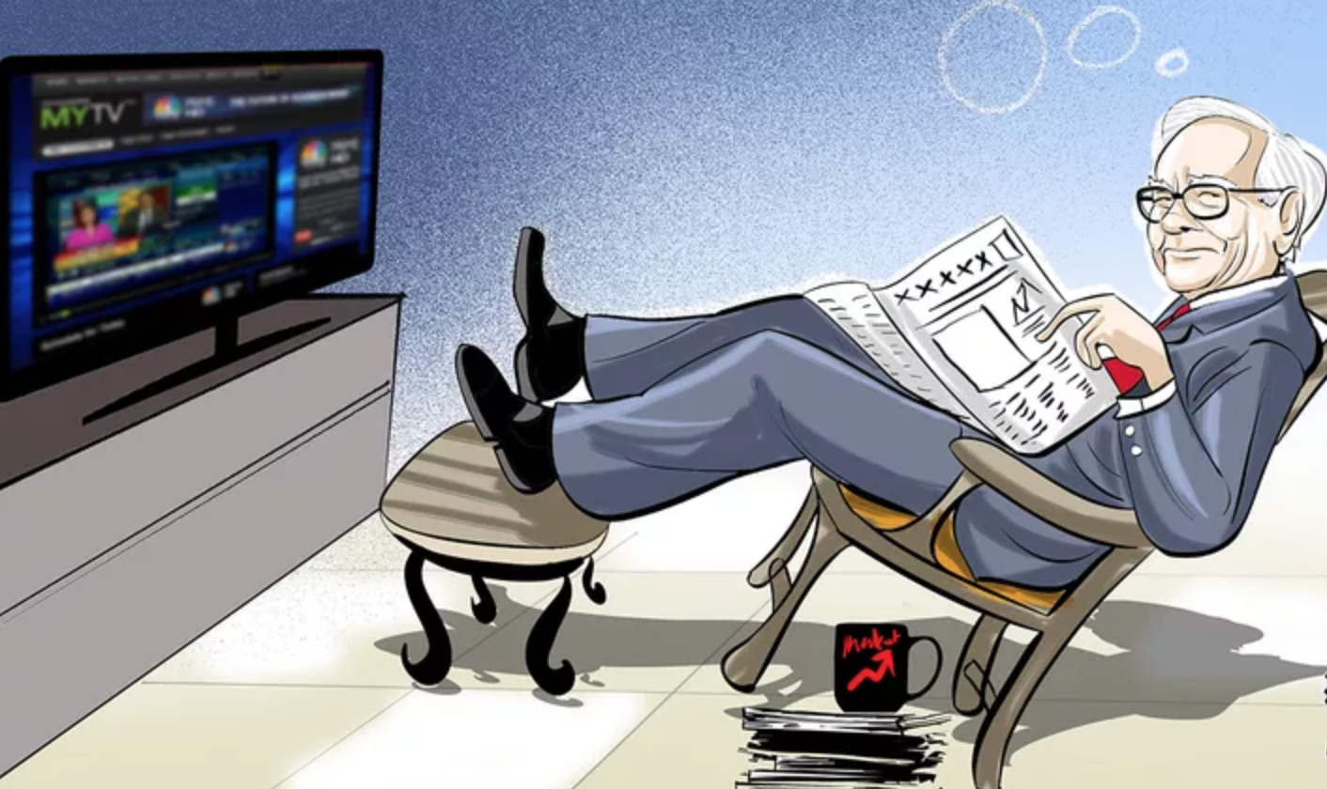
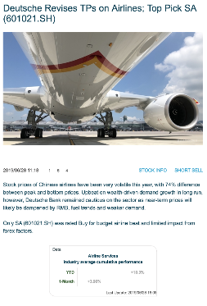

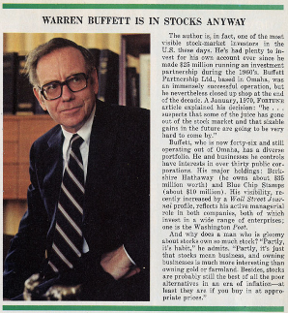
Problem Statement
Thousands of financial research reports published every minute
Digest reports quickly & make investment decision
Summarize key points from lots of narrative comments
The innovation challenge 1B (submitted by GPB) looks for a solution to improve customer experience based on the knowledge

Slide 3





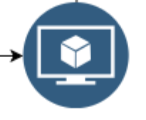

Solution and business case
“Chatbot Solution” summarize investment advice instantly
Google Cloud based solution:
- scan the research reports
- train model with continuous learning
The Chatbot:
User-friendly interface
Accessible from browser on
Interactive investor’s query with the result from
Extended to National Language Support
Address to the innovation challenge 1B
Trained Model

Slide 4
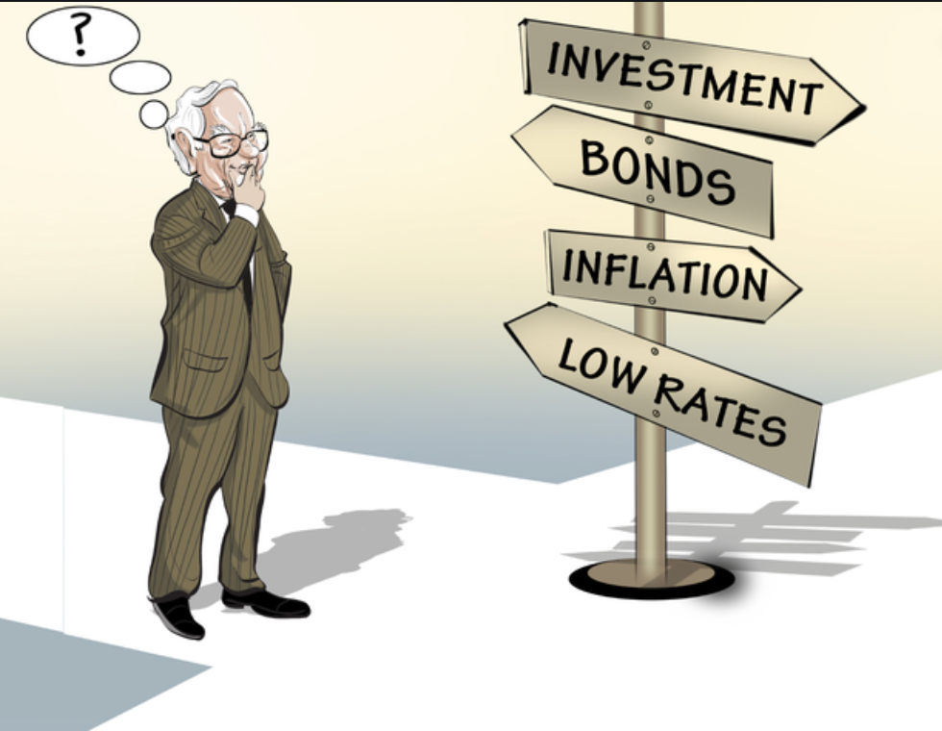
Benefit of “Chatbot Solution”
Facilitation on decision making
Superior reaction time to the market
Unlimited possibilities / opportunities

Slide 5











Architecture Logical Diagram
Research daily Financial report
Chatbot
Text / Voice
1. Upload PDF via API
9. Request
Financial advice
11. Response today financial predictions
Cloud Storage
10 Store / Retrieve
Prediction
2. Trigger Cloud function
Cloud Datastore
8. Run Application
(Python)
5. Labelled Data (Stock related entities)
Cloud Vision API
6. Supervised training data
3. Extract Text & convert format (using Python)
Cloud Machine learning
4. load formatted data
7. AutoML Natural Language Entity Extraction
Trained Model
Cloud Storage
Cloud AutoML

Slide 6

Chatbot Demo

Slide 7
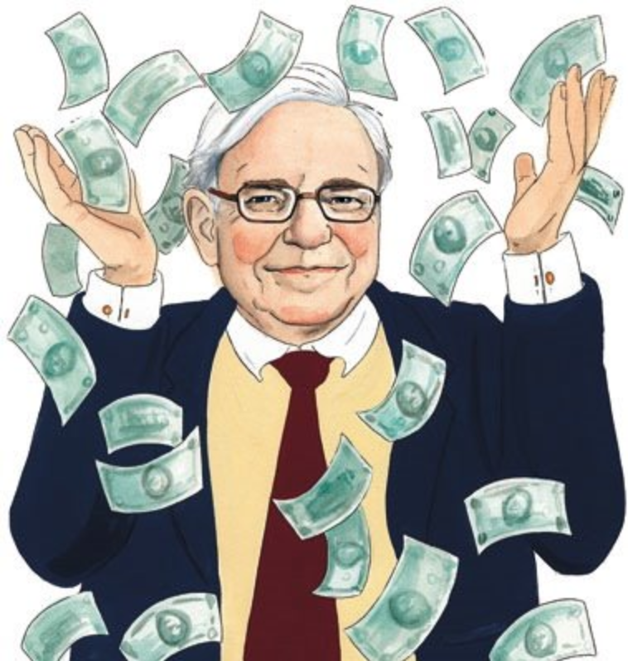
Thank You!!
😄
😄
😄
Enjoy Investing
Earn as much as you can!!
💸 💵 💴 💶 💷

Slide 9
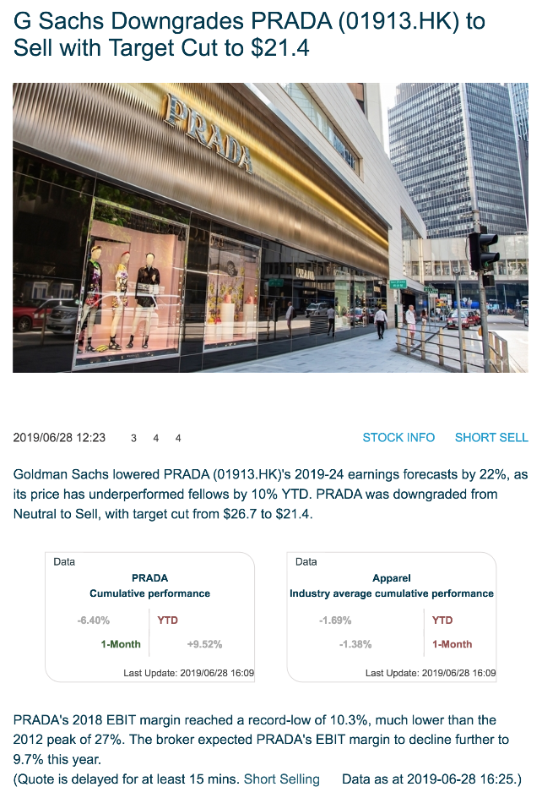


Slide 10
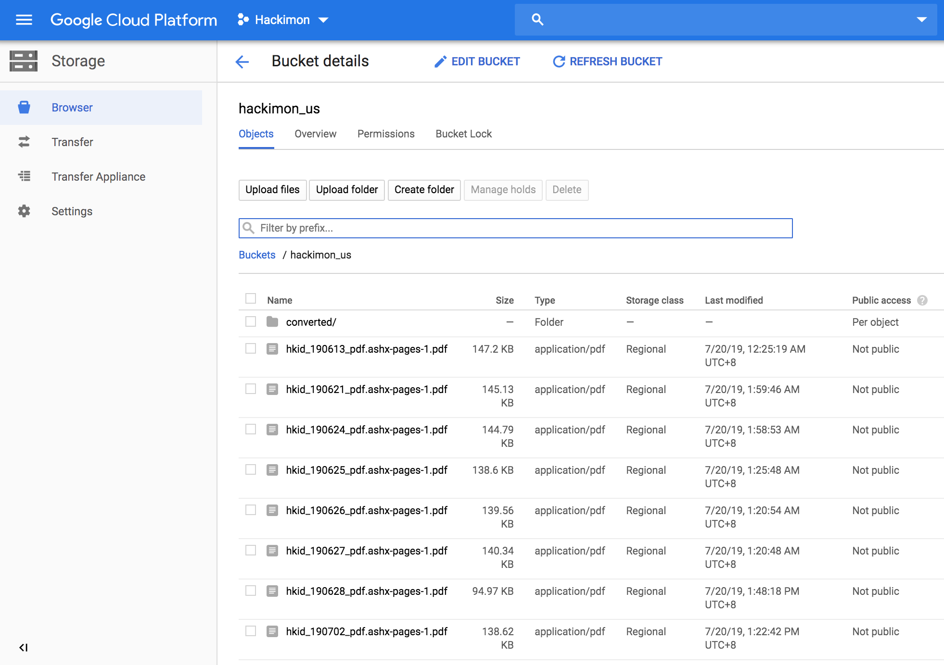

Slide 11
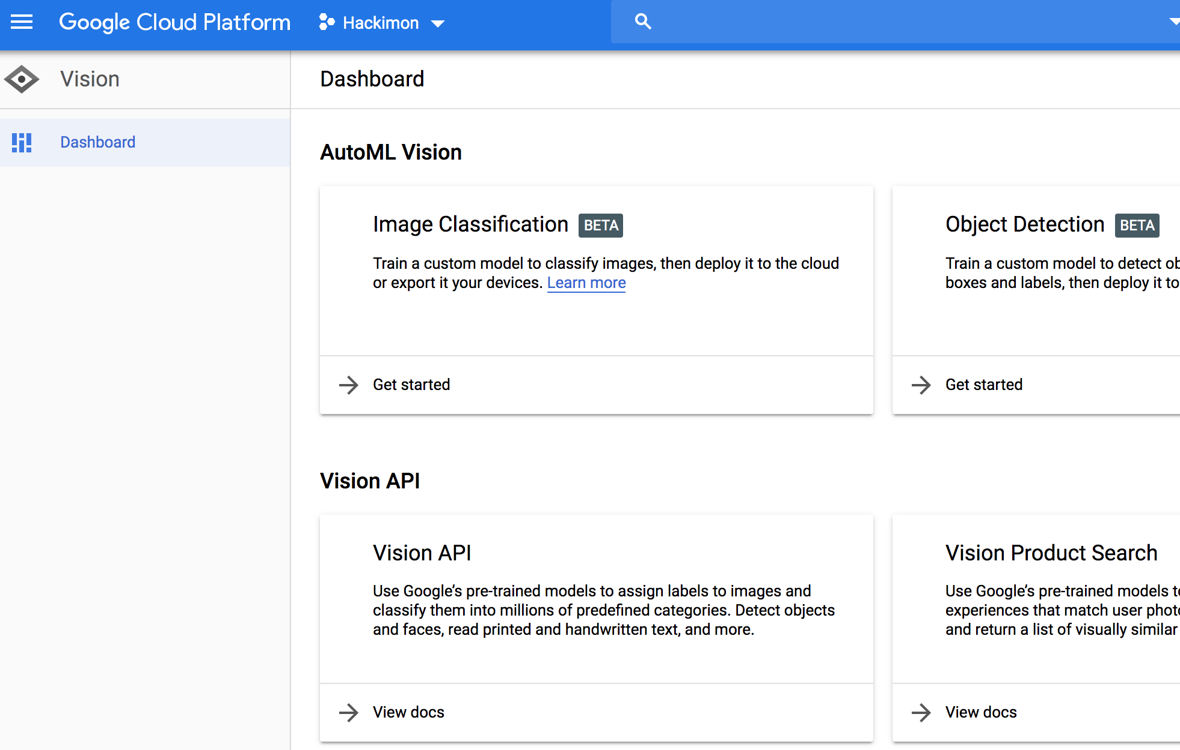

Slide 12
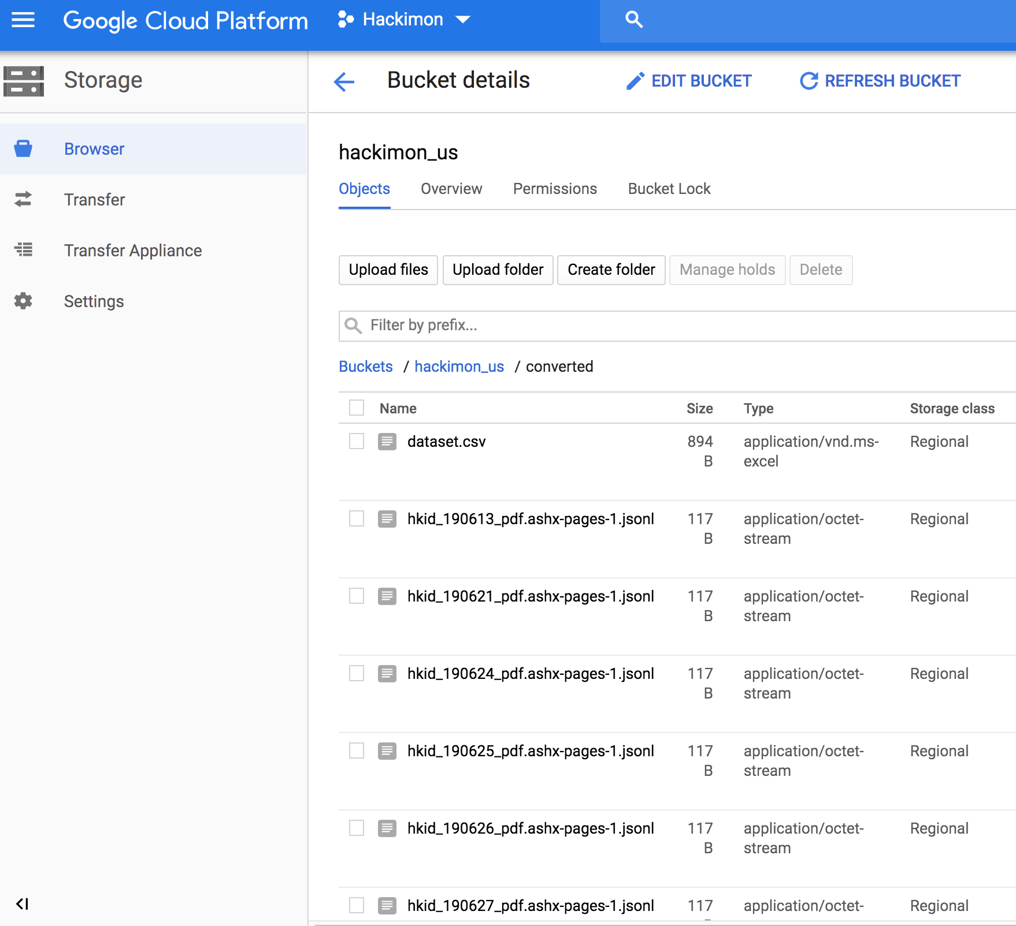

Slide 13
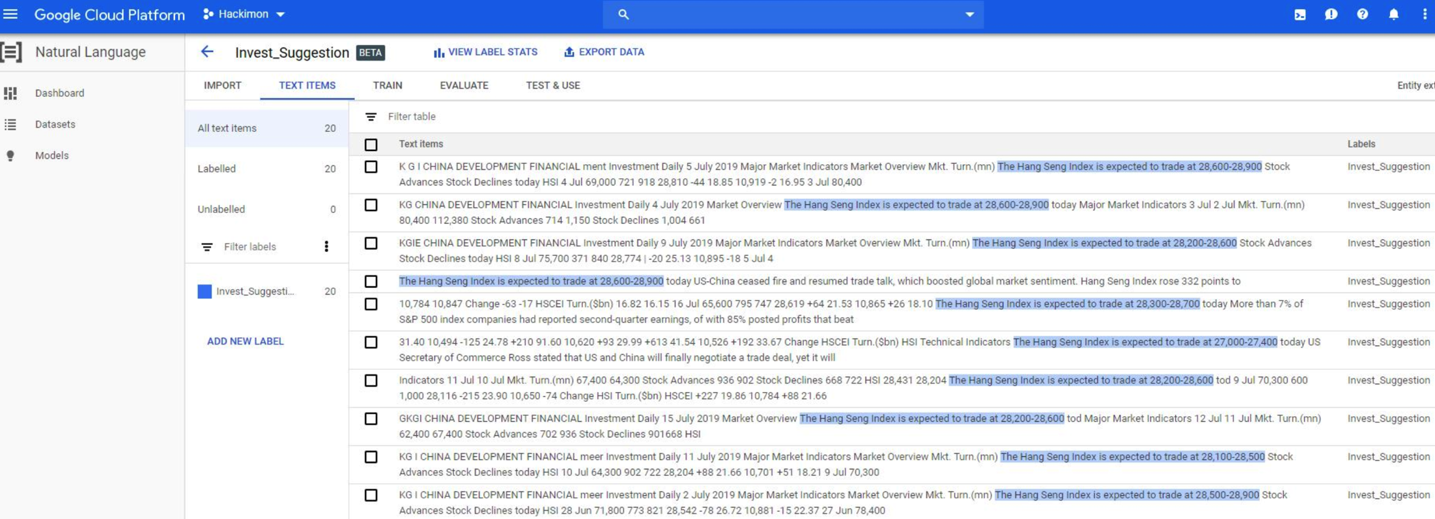

Slide 14
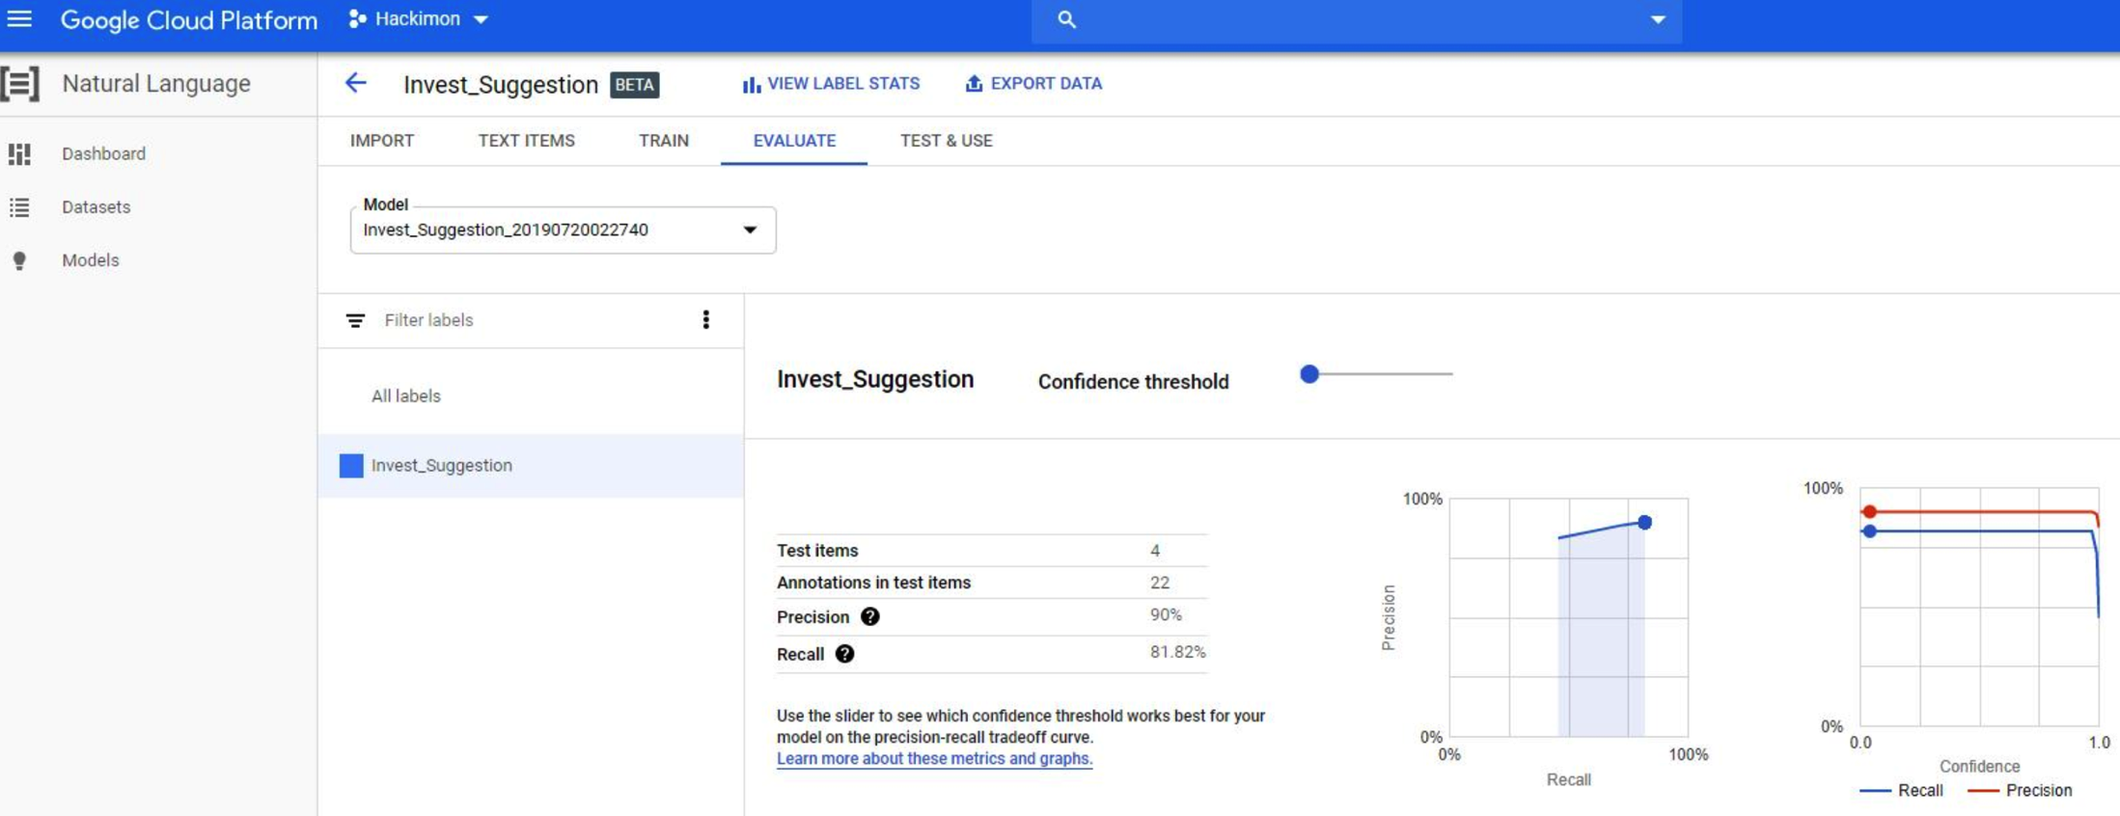

Slide 15
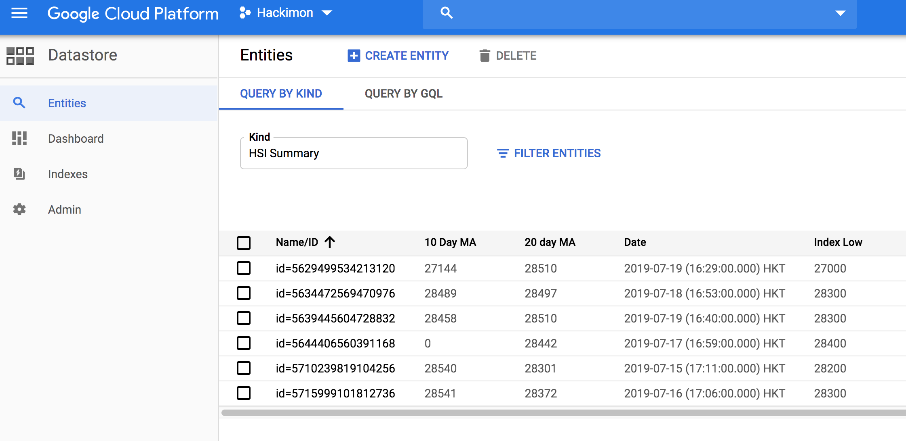

Slide 16
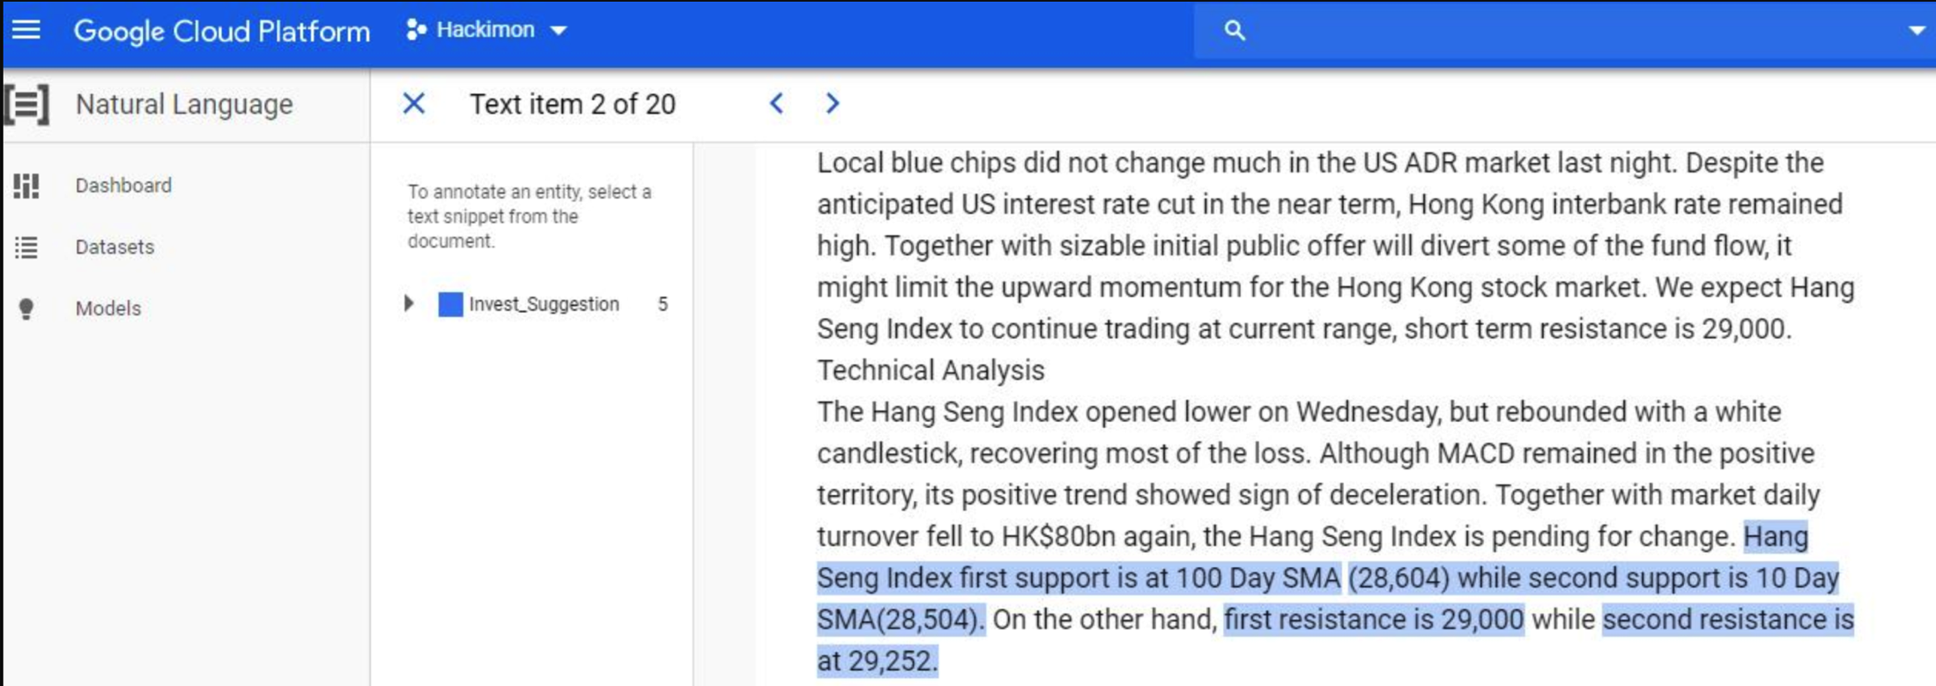

Slide 17
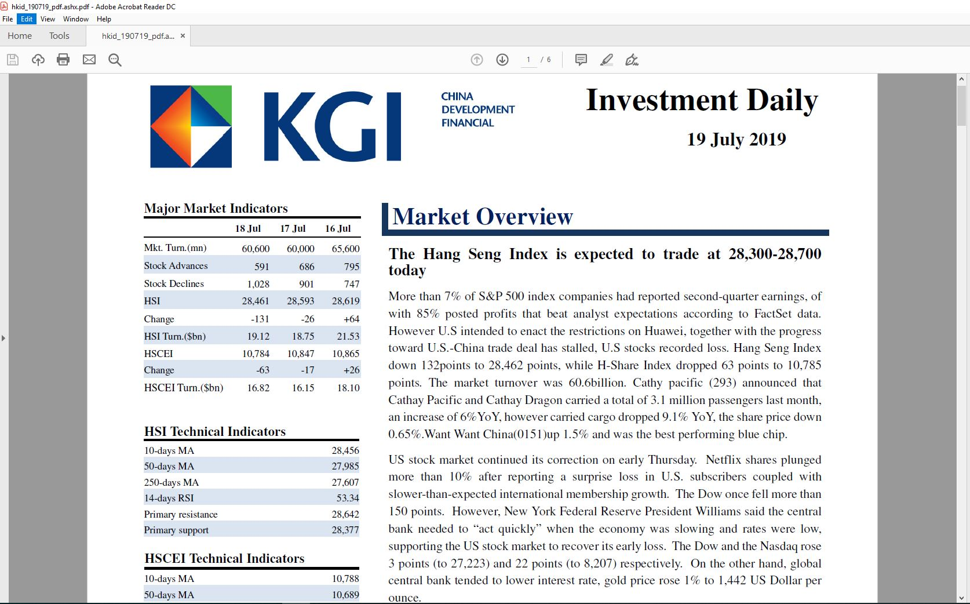

Slide 18
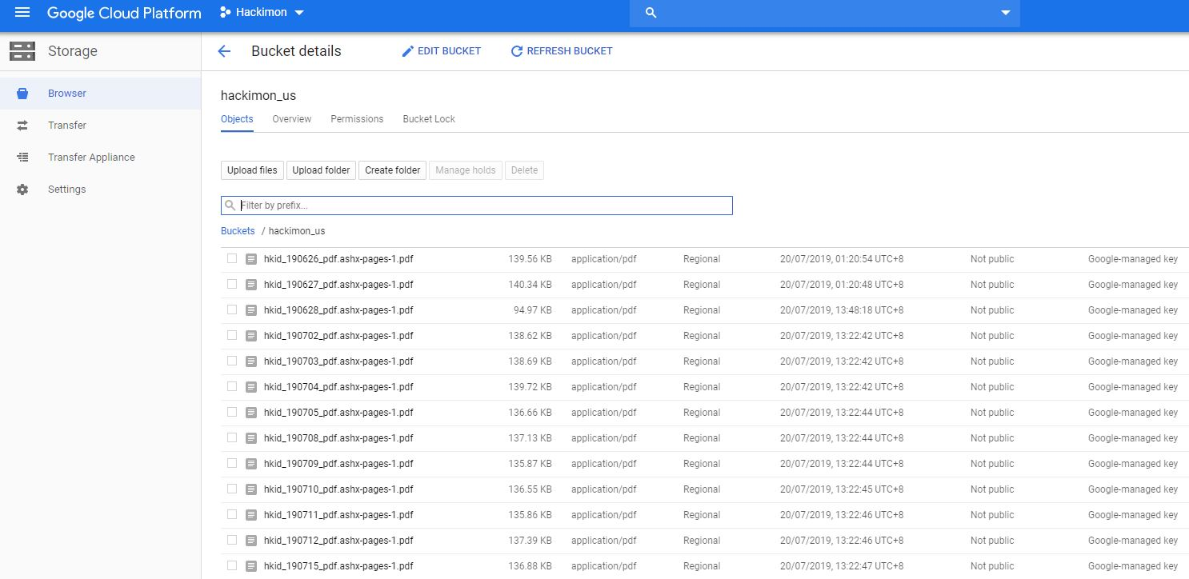

Slide 19
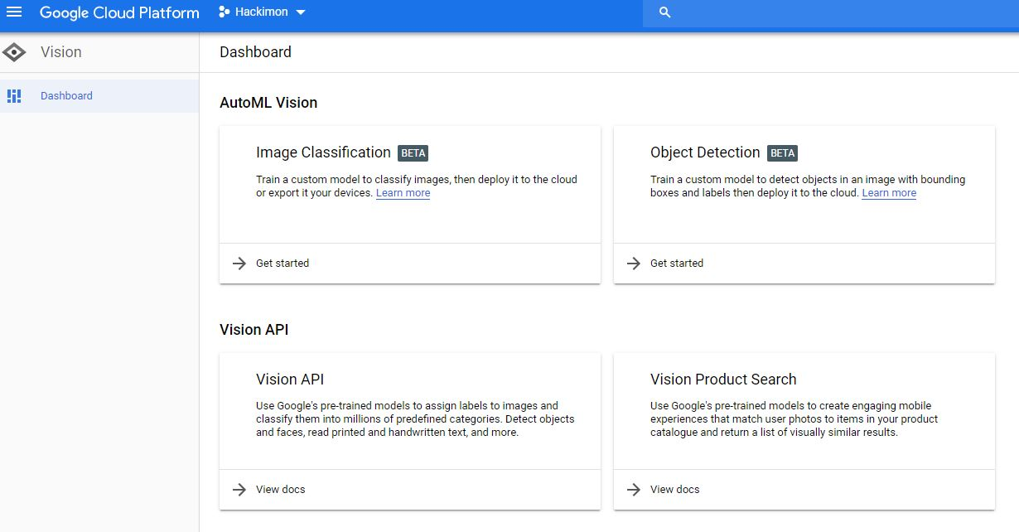

Slide 20
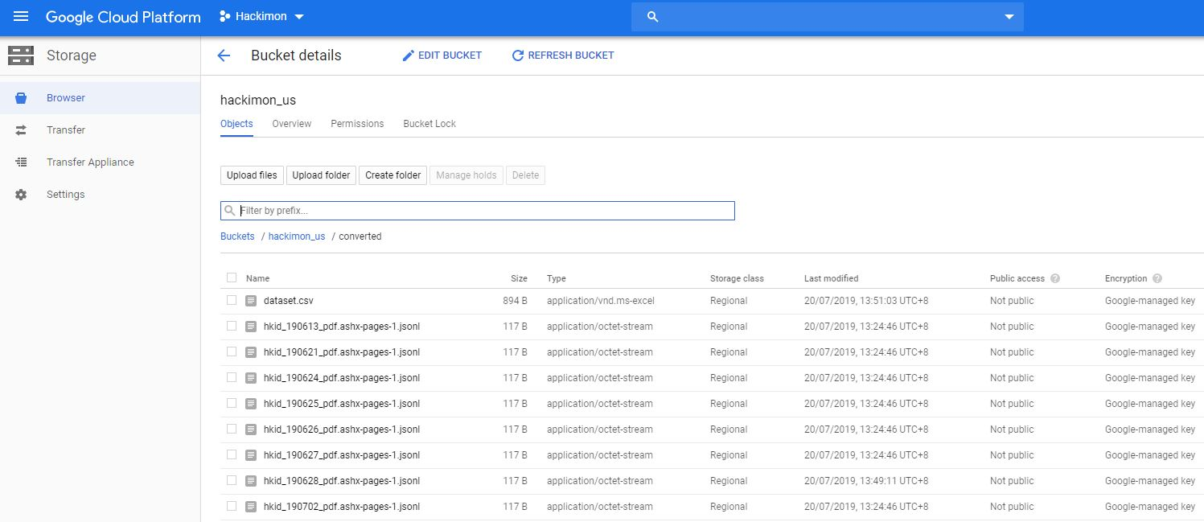

Slide 21
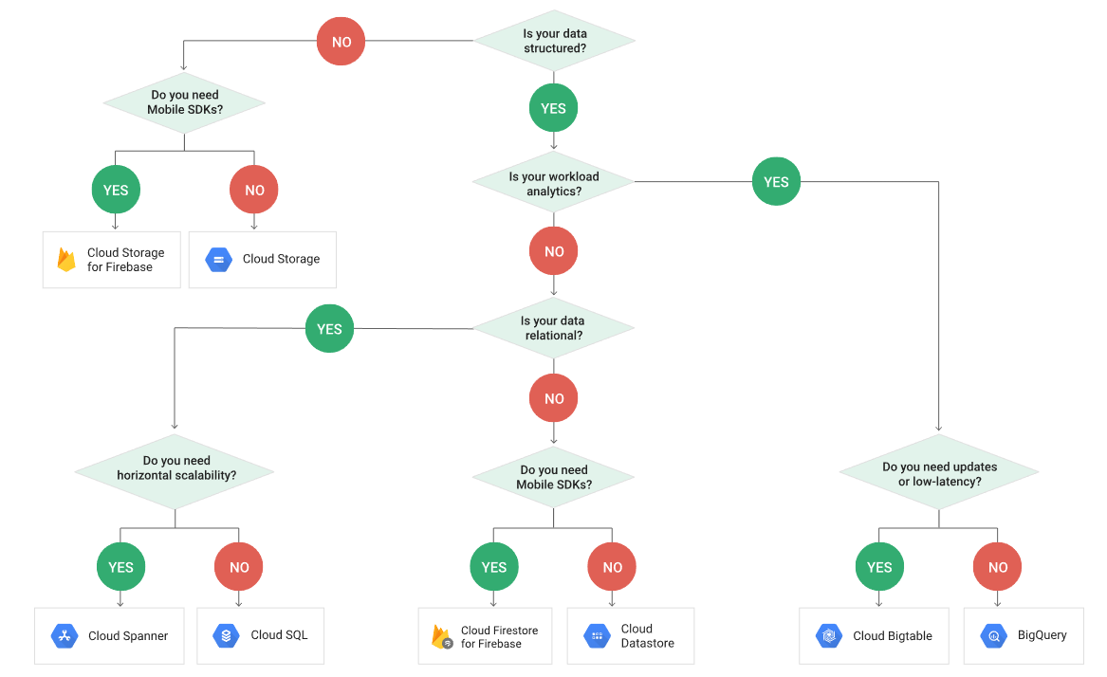

Slide 22
